Slide 1
PRACTICABLE DIRECT LIQUID APPLICATION
Definition of Practicable:
Capable of being put into practice, done, or accomplished

Slide 2
Craig Eldred Public Services Director City of Waconia, Minnesota
2018 Public Roads Deicing Workshop, October 25, 2018
DuPage County Division of Transportation
E-Mail celdred@waconia.org
Phone: 952-442-4265
www.waconia.org

Slide 3
Define Anti-icing as an action of Direct Liquid Application Define De-icing as an action of Direct Liquid Application Products and Impacts Management Strategies for Positive Results Questions and Comments
From This View
To This Result With Liquids

Slide 4
Anti-Icing: 1. A proactive approach to Winter Maintenance 2. Preventing the bond of snow and ice to a pavement surface 3. Reduces operational costs and environmental impacts 4. Not recommended before a rain fall or freezing rain

Slide 5
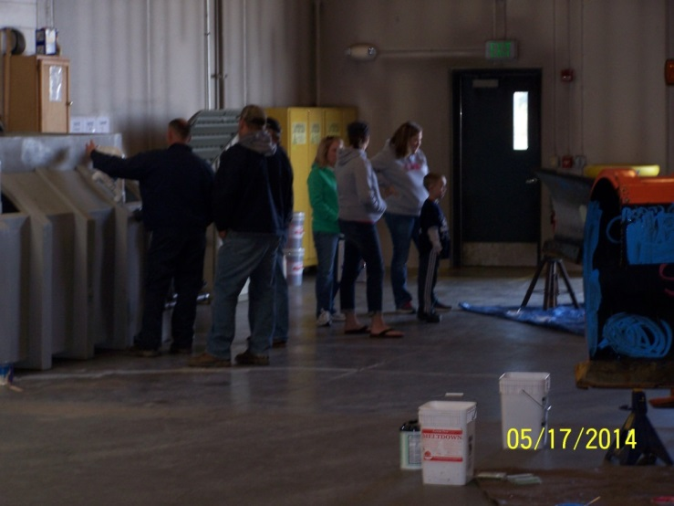
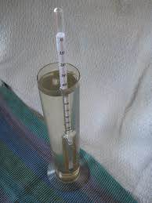
Direct Liquid
Application Anti-icing
Blend to Manage
Conditions
90 Brine, 10 MG/CA
80 Brine, 20 MG/CA
85 Brine, 15 RG-8 or Geomelt 55, 5 MG/CA
Application Rate
35 Gal/LM
Consideration of Cycle
Times from dilution
100% Brine
Application Rate
35 to 50 Gal/LM
Consideration of Cycle
Times from dilution

Slide 6
De-Icing With Liquids 1. Forward Thinking 2. Must be managed appropriately 3. Product Knowledge is Critical

Slide 7
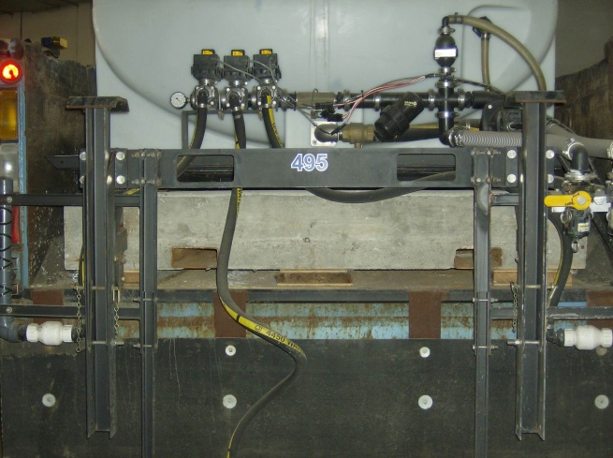
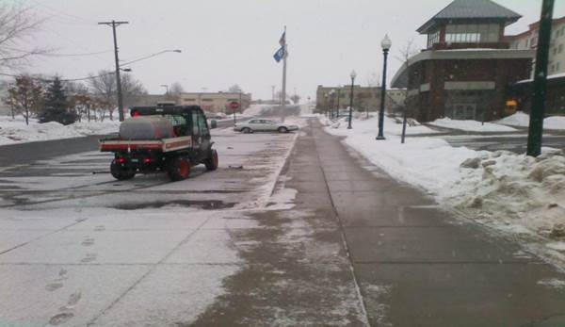
Direct Liquid
Application De-icing
Blend to Manage
Conditions
Mixtures
90 Brine, 10 Mg/CA
80 Brine, 20 Mg/CA
85 Brine, 15 RG-8 or
Geomelt 55, 5 Mg/CA
Application Rate
35 Gal/LM
Consideration of Cycle
Times from dilution
100% Brine
Application rate
35 to 50 Gal/LM
Consideration of Cycle Times from dilution

Slide 8
Critical Knowledge of Products and Impacts 1. Discuss products with supplier; Your intended use, and obtain information on its limitations 2. Visit Organizations that are advanced in the practice your desiring 3. Attend training to obtain information and bring back to your organization 4. Look at the products and their environmental impacts; then as a budgetary impact item

Slide 9
Management Strategies for Positive Results 1. Understanding limitations for yourself, staff, equipment 2. Obtain support from Boards or Councils 3. Educate Staff and the Public in General of your intentions, but start SMALL 4. Build your program knowing it is challenging and that you may fail at times

Slide 10
Management Strategies for Positive Results; Cont. 5. Light snow fall and frost events are easily accomplished with DLA 6. Moderate snow fall events that you have knowledge of its end-time and future forecasting 7. Light to Moderate rain, or Freezing rain can be managed keeping in mind that cycle times are necessary 8.Expunge information from periodicals and on the Web. Good Source is Clear roads new DLA Study

Slide 11
Craig Eldred Public Services Director City of Waconia (952) 442-4265 celdred@waconia.org

