Slide 1
NAVIGATING THE WINTER WITH THE ILLINOIS TOLLWAY
Joseph Dragovich
Roadway District 1 Manager

Slide 2
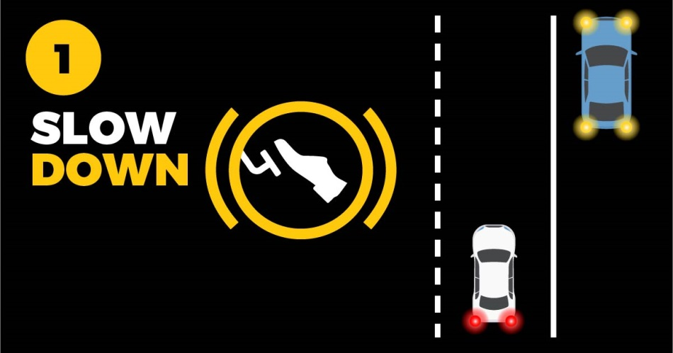
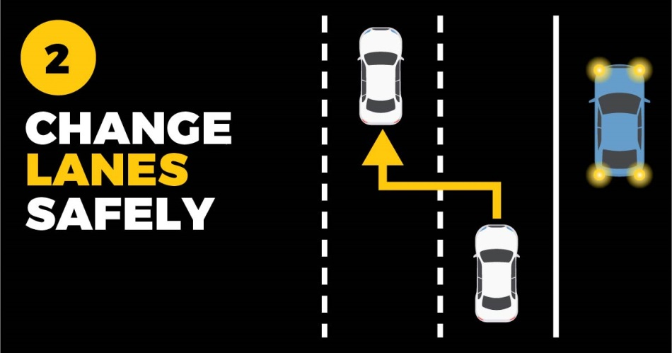
The “Move Over” Law requires passing drivers to slow down and change lanes safely when approaching ANY vehicle with their hazard lights on, not just emergency and maintenance vehicles.
WHAT TO DO
when you see ANY vehicle with flashing lights

Slide 3
ILLINOIS TOLLWAY FACTS
System opened 1958
Currently operate 294 center lane miles/2,200 total lane miles
Five interstates include:
Tri-State Tollway (I-94/I-294/I-80)
Jane Addams Memorial Tollway (I-90)
Reagan Memorial Tollway (I-88)
Veterans Memorial Tollway (I-355)
Elgin - O’Hare (I-390) opened July 2016

Slide 4
WINTER OPERATION FACTS
12 maintenance sections with 16 salt domes
103,000 tons of total bulk salt capacity
24/7 operation
Enhanced shift staffing November through April
“Off-hour” staffing to handle minor snow events
Can mobilize full crews in less than two hours
195 total snow routes

Slide 5
WINTER MISSION STATEMENT
The Illinois Tollway is dedicated to providing clear and safe pavement such that the existence of adverse weather will not affect the free flow of people, goods and services across the Tollway system

Slide 6
MECHANICAL REMOVAL OF SNOW
Primary means of snow removal
Standard carbon steel plow blades
Tested Kupper Blades
Plow-saver feature
Tandem plowing
Spread de-icing materials only when necessary at appropriate spread rate for conditions
Plow shoulders and gore points throughout the weather event
Reduces cleanup efforts
Reduces quantities of de-icing materials used during cleanup operations

Slide 7
PLOW-SAVER FEATURE
Takes most of the plow’s full weight off the cutting edge and transfers it to the front axle
Meters hydraulic oil pressure to the plow-lift cylinder
Reduces potential for plow jamming and tripping on obstructions such as bridge dams
Reduces the wear rate of the cutting edge, significantly increasing blade life
Provides greater stability of handling and steering, particularly on ramps and turns
Eliminates the need for plow shoes
Minimizes incidental plow damage

Slide 8
TANDEM PLOWING
Most effective method of removing large accumulations of snow from the roadway
Requires specific training and a coordinated effort
All mainline trucks equipped with wing plows
All lanes plowed to the right
Minimizes excess snow on median shoulder
Ramp trucks may assist
Uses traffic
Reduces cleanup after the storm event

Slide 9
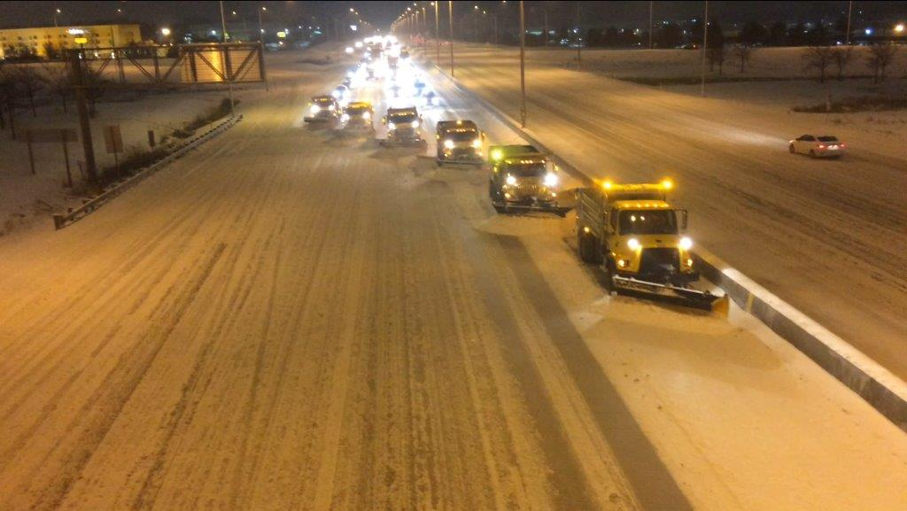
TANDUM PLOWING OPERATION

Slide 10
TECHNOLOGY ON THE ROAD
19 roadway weather information stations (R.W.I.S)
Web-based, full access from any computer
All plow trucks equipped with air and pavement temperature sensors
Fully calibrated, computer-controlled spreaders
All trucks equipped with automatic vehicle location systems (AVL)
Monitor plowing speed
Monitor assigned spread rates
Ability to verify route timing

Slide 11
DECENTRALIZED OPERATIONS
Each maintenance section has two supervisors
Field staff have authority and are expected to adjust storm event “game plan” according to conditions
Snow intensity (light, moderate, heavy)
Rapid accumulation (1 inch or more per hour)
Traffic (peak, off-peak)
Temperatures
Manpower
Spread rates

Slide 12
2017-2018 WINTER SEASON
Tollway documented 21 snow events
Included three freezing rain/ice events
33 inches of snow
61,000 Tons of Salt used
7800 tons of Abrasives
33,500 gals. of Calcium Chloride
41,000 gals of BEET HEET
Lessons learned

Slide 13
SALT CONSERVATION
Driven by environmental and fiscal realities
Strike a balance between environmental impacts and providing safe level of service for customers
“Off-peak” spreading reduced in favor of plowing
Field decisions constantly monitored and reviewed by supervisory staff
Computerized, hourly condition reporting by maintenance site staff

Slide 14
QUESTIONS?
Joseph Dragovich
Illinois Tollway
Roadway District 1 Manager
630-241-6800, ext. 3911
jdragovich@getipass.com

